Slide 1
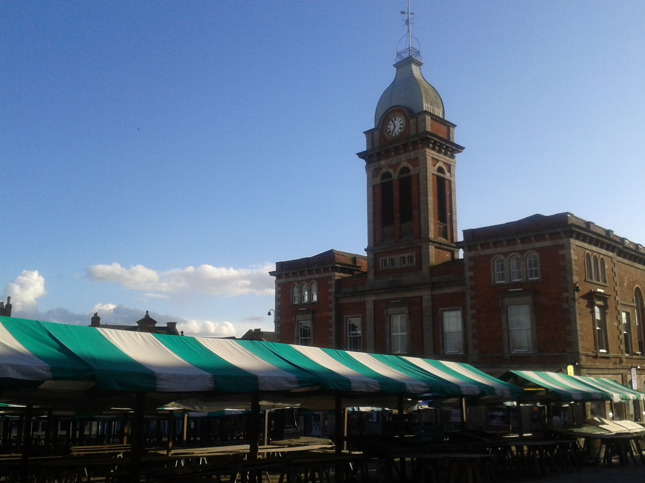
Perceptions of Chesterfield and Chesterfield English
Claire Ashmore
7th Northern Englishes Workshop, The University of Edinburgh
C.Ashmore@shu.ac.uk

Slide 2
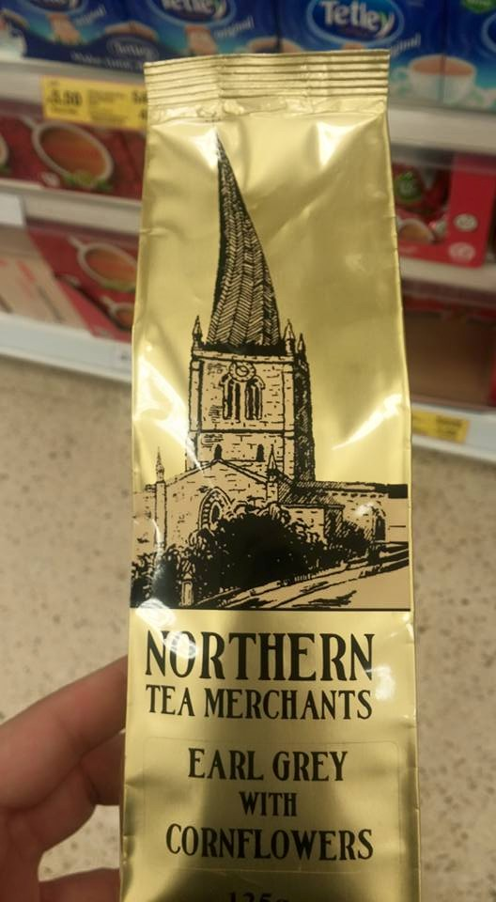
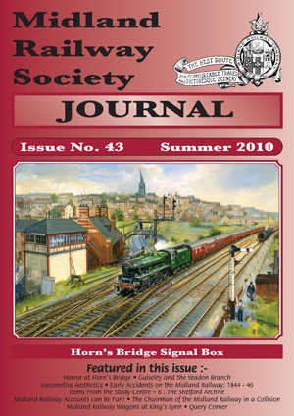

Slide 3
Is Chesterfield in the North, South or Midlands?:
“Not quite the north and not quite midlands.” (Chesterfield female, pilot study.)
“I consider myself a northern bloke. Everyone in Chesterfield considers themselves northern, surely?” (The Chesterfield Forum, 2010)
“The north starts on the boundary with south yorkshire (the place dee dars come from.)” (The Chesterfield Forum, 2010, emphasis not author’s own.)

Slide 4
What is distinctive about Chesterfield speech (accent and vocabulary)?
“common”/ ”quite rough”/”quite friendly – not considered posh/uptight.”
It’s “quite similar to the Sheffield accent in many ways”/The Sheffield dialect has ”no particular difference to the Chesterfield one.”
“…unique compared to other places nearby such as Sheffield.” (All taken from teenage responses before perception recognition tasks.)

Slide 5
Could you recognize a Chesterfield/Sheffield/Derby/Nottingham accent?
Perception that dialect could be recognized if vocabulary acted as a cue:
Chesterfield people use “cob” but there’s “bloodshed” if you use it in Sheffield. (Chesterfield female, pilot study.)

Slide 6
Today’s paper
Chesterfield background
Initial results of perceptual mapping task – teenagers from Chesterfield
Initial results of dialect recognition tasks – teenagers from Chesterfield
Conclusions and future work

Slide 7
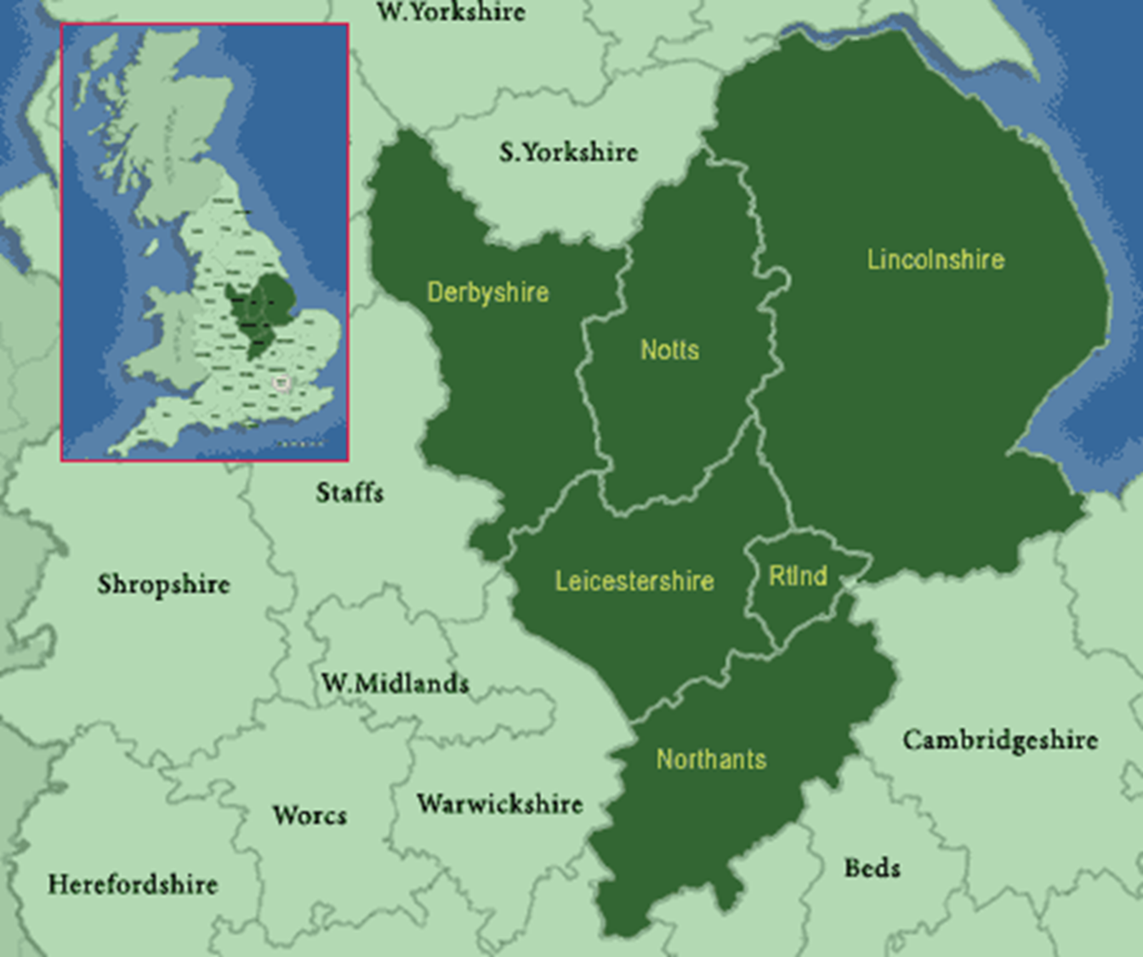
Figure 1. Map of the East Midlands: http://www.picturesofengland.com/

Slide 8
(Perceptual) Dialect boundaries
Dialect boundaries seem to converge in this area (Montgomery’s “line density map of all dialect typologies”, 2016: 189.)
BUT:
Upton’s (2012) belief that the Midlands is a transition zone, and all boundaries are blurred.
Non-linguists’ belief in (dialect) boundaries:
McMillan’s (2011) anecdotal account of the MOUTH vowel isogloss between Chesterfield and Sheffield.
Finnegan’s (2011: 338) strong perceptual linguistic boundary between Sheffield and Chesterfield regarding the FACE vowel.

Slide 9
2) Perceptual Mapping Tasks
Adolescent group: 3 secondary schools in Chesterfield.
39 Year 12 Chesterfield students tested:
9 drew one line, a north-south divide. Nobody put Chesterfield in the South.
30 drew a Midlands area. Chesterfield was placed in the Midlands 28 times, the North 2 times and the South 0 times.
Of 39 responses, Chesterfield was placed in the North 28% of the time, and the Midlands 72%.
Consistent with Braber (2014), where Derbyshire students placed Chesterfield in the Midlands (or ‘said they were ‘neither’ Northern nor ‘Southern’).
In future, how respondents answered (Chesterfield in North or Midlands) will be analysed against their pronunciation (of FACE/MOUTH/GOAT vowels).

Slide 10
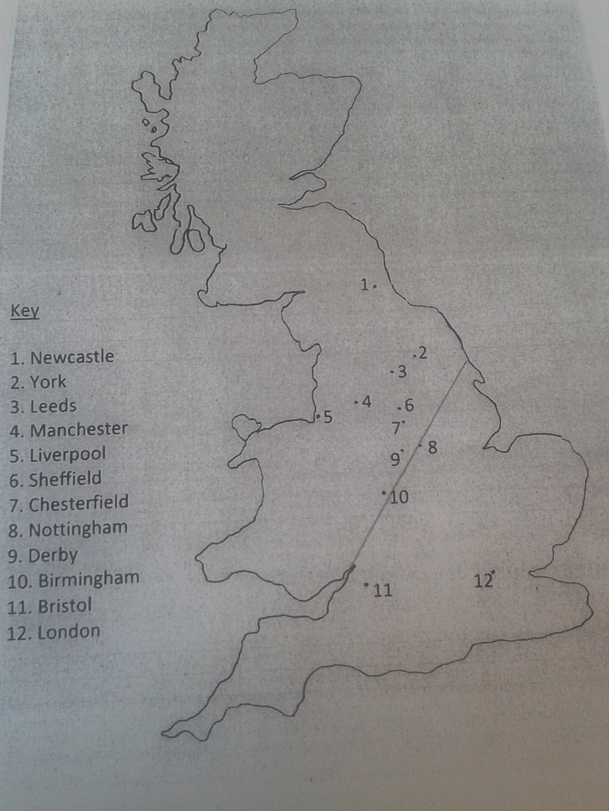
Figure 2. Map used in data collection with Chesterfield adolescents.
Scale precise but borders of the country imprecise – subsequently georeferenced using ArcGIS 10.3.

Slide 11
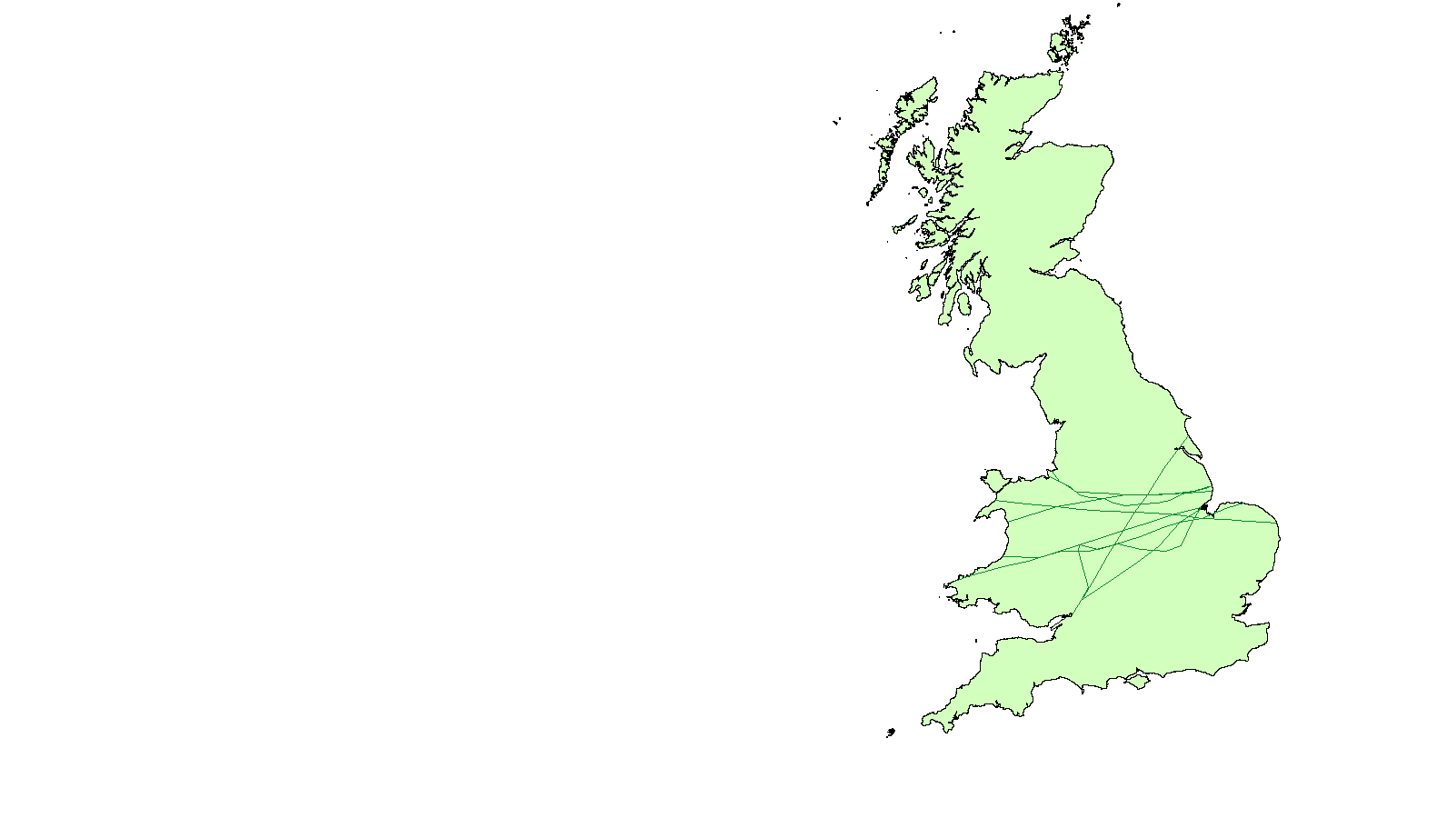
North/South dividing line further down the country than Braber (2014), but fewer responses analysed here.
Figure 3. Map of North/South Dividing line by Chesterfield adolescents.
Map created using ArcGIS 10.3.

Slide 12
3) Dialect recognition tasks
Teenagers have been found to be poor at recognizing dialect from their own region, in comparison with adults (Williams, Garrett, & Coupland, 1999).
WHY?
Inadequate experience? Phonological differences in the test?
BUT if patterns in the “mistakes” concerning the dialects erroneously claimed as part of the in-group….
Found to be affective factors, claiming/denial:
“Listeners did not merely recognise or fail to recognise speakers as belonging to specific communities. In some respects, their identifications responded to and manipulated the group designations that we offered them. Most notably, there was a tendency for a very likable speaker to be actively appropriated into the in-group.” (Williams, Garrett, & Coupland 1999: 357).

Slide 13
Affective factors, or lack of positive cultural qualities…?
Local dialects not recognised among Nottingham teens:
Why?
Nottingham’s lack of positive cultural qualities and a negative reputation “…caused these students to misrecognise or deny that a Nottingham accent belongs to them.” (Braber 2016: 231).

Slide 14
The tests:
In 2 parts:
Can they recognize older male, and younger female, from Chesterfield, Sheffield, Nottingham and Derby reading a short paragraph.
Can free answers to vocabulary questions help them recognize where the speaker is from? (Remember the perception that dialect could be recognized if vocabulary acted as a cue.)
Was the Chesterfield dialect recognized, or claimed, by the adolescent judges?

Slide 15
Chesterfield male

Slide 16
Chesterfield female

Slide 17
Why the Chesterfield male isn’t recognized/claimed:
Chesterfield male sounds “posh” (affective factor):
They thought he was from Derby/Nottingham for the accent as he “sounds like the most southern of them all” (despite the Derby male using a long /a/ in ‘Aunt’/’Aunty’).
They couldn’t recognise the vocabulary he used (generational/test factor):
They don’t know the word ‘twitchel’ (path) and he doesn’t say ‘cob’ (bread roll).
“Perceptual dislocation” (Kerswill and Williams, 2002: 194): Rapid levelling has meant younger locals don’t connect older speech with the town (as with Reading)?

Slide 18
Why the Chesterfield female is recognized/claimed:
Chesterfield female sounds “familiar” (phonological recognition? generational factor?):
“Sounds the nearest to the local area to me”
Chesterfield female uses current vocabulary (generational factor):
”…same words for bread roll/passage between houses as me”.

Slide 19
Sheffield male

Slide 20
Sheffield female

Slide 21
Why is the Sheffield female recognized?
She is recognised is being from Yorkshire (cultural prominence/proximity):
She “…sounds very Dee dar”.
Her accent and vocabulary are recognised (cultural prominence/generational difference/proximity):
“Words like ‘Dave’” and ”Breadcake”. “ …’clurthes’ instead of ‘clothes’” (FACE and GOAT vowel).

Slide 22
Proximity and Cultural Prominence
“Cultural prominence”, along with proximity, important for dialect recognition:
Manchester has become a recognised dialect area to non-linguists, perhaps due to (positive?) media attention (Montgomery 2016).
Sheffield, arguably, has more cultural prominence than anywhere in the East Midlands. Is there such a thing as “local” or “regional” cultural prominence?
Sheffield is the closest city to Chesterfield (10 minutes by train).

Slide 23
4) Conclusions and future work
My results show that Chesterfield is mostly considered to be in the Midlands by Chesterfield teens.
Dialect recognition:
The teenagers were not good at recognizing older males from any of the local towns and cities.
The teenagers were good at recognizing the younger females from Chesterfield and Sheffield – why? What were the linguistic cues?
How does dialect recognition vary with older “judges”?
Is perception of regional identity reflected in vowel sounds used by Chesterfield locals?

Slide 24
References
Braber, N. (2014). The Concept of Identity in the East Midlands of England: Investigating Feelings of Identity in East Midlands’ Adolescents. English Today 118, 30 (2); 3-10.
Braber, N. (2016). Dialect Perception and Identification in Nottingham. In J. Cramer and C. Montgomery (Eds.). Cityscapes and Perceptual Dialectology. Global Perspectives on Non-Linguists’ Knowledge of the Dialect Landscape. Berlin: De Gruyter Mouton. 209-231.
Finnegan, K. (2011). Linguistic Variation, Stability and Change in Middle-Class Sheffield English. (Doctoral dissertation). Sheffield: The University of Sheffield.
Kerswill, P. and Williams, A. (2002). Dialect Recognition and Speech Community Focusing in New and Old Towns in England: The Effects of Dialect Levelling, Demography and Social Networks. In D. Long and D.R. Preston (Eds.). Handbook of Perceptual Dialectology: Volume 2. Philadelphia: John Benjamins Publishing Company. 173-204.
McMillan, I. (2011). Featured in Fry’s Planet Word – Series 1, Episode 2. Accessed on 31.03.2016 from https://www.youtube.com/watch?v=L-sxqAtNehY

Slide 25
Continued…
Montgomery, C. (2016). Perceptual Dialectology in Great Britain. In J. Cramer and C. Montgomery (Eds.). Cityscapes and Perceptual Dialectology. Global Perspectives on Non-Linguists’ Knowledge of the Dialect Landscape. Berlin: Mouton de Gruyter. 185-207.
The Chesterfield Forum. (2010). Accessed on 31.03.2016 from http://www.chesterfieldforum.net/threads/chesterfield-a-northern-town-or-a-midlands-town.2267/
Upton, C. (2012). The importance of being Janus: Midland speakers and the “North-South Divide”. Middle and Modern English Corpus Linguistics. John Benjamins Publishing Company, 257-267.
Williams, A., Garrett, P., and Coupland, N. (1999). Dialect Recognition. In D.R. Preston (Ed.). Handbook of Perceptual Dialectology: Volume 1. Philadelphia: John Benjamins Publishing Company. 345-358.

