Slide 1
Loss of mobility
Why Scandinavian V-to-I keeps getting mislaid
Caroline Heycock
University of Edinburgh
CGSW27@Yale
1st June 2012

Slide 2
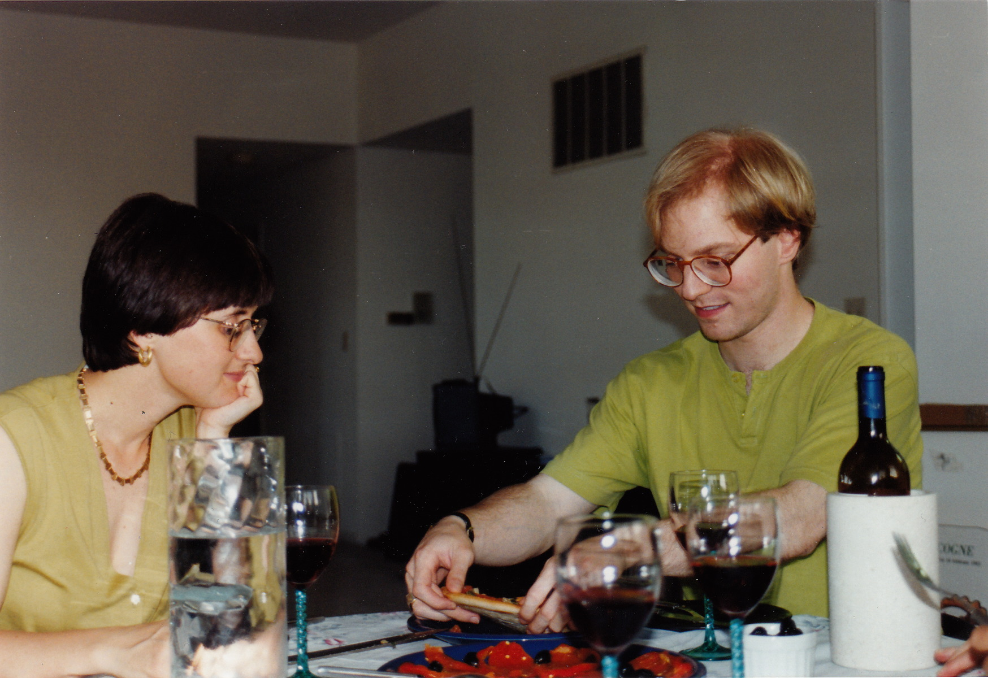
CGSW 27: a long time a-planning

Slide 3

Limited mobility
Work reported here has been done in collaboration with:
  Joel Wallenberg (Newcastle)
  Antonella Sorace (Edinburgh, Tromsø)
  Zakaris Svabo Hansen (Faroe Islands)
  Frances Wilson (Delaware)
  Sten Vikner (Aarhus)
Some was part of a larger project on verb movement in Faroese
http://www.lel.ed.ac.uk/~heycock/faroese-project
supported by a grant from the Arts and Humanities Research Council (AHRC)

Slide 4
Outline
The syntax/morphology interface and theories of V-to-I
  A synchronic testcase: Faroese
  A diachronic testcase: Danish
The problem of gradual change
Potential solution One: acquisition bias
  Acquisition patterns in Swedish, Tromsø Norwegian, Faroese
Potential solution Two: differential ambiguity
  What happens when Icelandic meets Swedish

Slide 5
V-to-I in Scandinavian
V-in-situ
Danish, based on Vikner (1995)
1. Hon var glad for …
she was happy
b. … at Bo ikke har læst denne bog.
that Bo neg has read this book
… that [Bo hasn’t read this book].
a. * … at Bo har Bo ikke har læst denne bog.
that Bo has neg read this book
… that [Bo hasn’t read this book].
c. * … at denne bog har Bo ikke har læst denne bog.
that this book has Bo neg read
… that [this book, Bo hasn’t read].

Slide 6
V-to-I in Scandinavian
V-in-situ + Embedded Verb Second (EV2)
Danish, from Vikner (1995), p. 67.
1. Vi ved …
we know
a. … at Bo ikke har læst denne bog.
that Bo neg has read this book
… that [Bo hasn’t read this book].
b. … at Bo har Bo ikke har læst denne bog.
that Bo has neg read this book
… that [Bo hasn’t read this book].
c. … at denne bog har Bo ikke har læst denne bog.
that this book has Bo neg read
… that [this book, Bo hasn’t read].

Slide 7
V-to-I in Scandinavian
Danish, from Vikner (1995), pp. 109ff
1. Hvordan sagde hon …
how said she
How_{i} did she say
a. … at børnene altid havde lært historie?
that children-def always had learned history
… that [the children always had learned history t_{i} ].
b. *… at børnene havde børnene altid havde lært historie?
that children-def had always learned history
… that [the children had always learned history t_{i} ].
c. * … at i skolen havde børnene altid havde lært historie?
that in school had children-def always learned history
… that [in school had the children always learned history t_{i} ].

Slide 8
V-to-I in Scandinavian
Icelandic, from Vikner (1995), pp. 109ff
1. Hvernig sagði hún …
how said she
How_{i} did she say
a. * … að börnin alltaf hafðu lært sögu?
that children-def always had learned history
… that [the children had always learned history t_{i} ].
b. … að börnin hafðu alltaf hafðu lært sögu?
that children-def had always learned history
… that [the children had always learned history t_{i} ].
c.?? … að í skólanum hafðu börnin alltaf hafðu lært sögu?
that in school had children-def always learned history
… that [in school had the children always learned history t_{i} ].

Slide 9
The Rich Agreement Hypothesis (RAH)
The strong RAH:
  The verb moves to a distinct Agreement/Argument head above Negation if agreement morphology is rich
  rich agreement → V-to-I
  The verb stays in situ in the VP if agreement morphology is not rich
  V-to-I → rich agreement
The weak RAH:
  The verb moves to a distinct Agreement head above Negation if agreement morphology is rich
  rich agreement → V-to-I
  The verb may or may not stay in situ in the VP if agreement morphology is not rich
  V-to-I → rich agreement

Slide 10
The Rich Agreement Hypothesis (RAH)
How rich is rich?
Rohrbacher 1994, Vikner 1997, Koeneman & Zeijlstra 2011: if there are enough overtly marked distinctions in the person morphology
e.g. K&Z: it must take no less than 3 binary features to characterize the paradigm (crosslinguistically, the minimum needed for pronominal paradigms)
Bobaljik & Thráinsson 1998, Bobaljik 2002, Thráinsson 2010: if there is distinct affixal morphology for agreement and tense co-present.

Slide 11
Icelandic
kasta | Present |  |  | Past
 | Singular | Plural |  | Singular | Plural
1st | kasta | köstum |  | kastaði | köstuðum
2nd | kastar | kastið |  | kastaðir | köstuðuð
3rd | kastar | kasta |  | kastaði | köstuðu
Danish
kaste | Present |  |  | Past
 | kaster |  |  | kastede

Slide 12
A synchronic test case: Faroese
What do current theories predict about V-to-I in Faroese?
How much agreement morphology does Faroese have?
What are the facts about V-to-I in modern Faroese?

Slide 13
A synchronic test case: Faroese
What do current theories predict about V-to-I in Faroese?
How much agreement morphology does Faroese have?
What are the facts about V-to-I in modern Faroese?

Slide 14
A synchronic test case: Faroese
What do current theories predict about V-to-I in Faroese?
How much agreement morphology does Faroese have?
What are the facts about V-to-I in modern Faroese?

Slide 15
Icelandic
kasta | Present |  |  | Past
 | Singular | Plural |  | Singular | Plural
1st | kasta | köstum |  | kastaði | köstuðum
2nd | kastar | kastið |  | kastaðir | köstuðuð
3rd | kastar | kasta |  | kastaði | köstuðu
Danish
kaste | Present |  |  | Past
 | kaster |  |  | kastede
Faroese
kasta | Present |  |  | Past
 | Singular | Plural |  | Singular | Plural
1st | kasti | kasta |  | kastaði | kastaðu
2nd | kastar | kasta |  | kastaði | kastaðu
3rd | kastar | kasta |  | kastaði | kastaðu

Slide 16
A synchronic test case: Faroese
What do current theories predict about V-to-I in Faroese?
How much agreement morphology does Faroese have?
What are the facts about V-to-I in modern Faroese?

Slide 17
A synchronic test case: Faroese
What do current theories predict about V-to-I in Faroese?
How much agreement morphology does Faroese have?
  Strong RAH: Not enough to allow V-to-I
  Weak RAH: Not enough to require V-to-I (?)
What are the facts about V-to-I in modern Faroese?

Slide 18
A synchronic test case: Faroese
What do current theories predict about V-to-I in Faroese?
How much agreement morphology does Faroese have?
  Strong RAH: Not enough to allow V-to-I
  Weak RAH: Not enough to require V-to-I (?)
What are the facts about V-to-I in modern Faroese?

Slide 19
Recall: V2 creates islands...
Danish, from Vikner (1995), pp. 109ff
1. Hvordan sagde hon …
how said she
How_{i} did she say
a. … at børnene altid havde lært historie?
that children-def always had learned history
… that [the children always had learned history t_{i} ].
b. *… at børnene havde børnene altid havde lært historie?
that children-def had always learned history
… that [the children had always learned history t_{i} ].
c. * … at i skolen havde børnene altid havde lært historie?
that in school had children-def always learned history
… that [in school had the children always learned history t_{i} ].

Slide 20
... but V-to-I doesn’t
Icelandic, from Vikner (1995), pp. 109ff
1. Hvernig sagði hún …
how said she
How_{i} did she say
a. * … að börnin alltaf hafðu lært sögu?
that children-def always had learned history
… that [the children had always learned history t_{i} ].
b. … að börnin hafðu alltaf hafðu lært sögu?
that children-def had always learned history
… that [the children had always learned history t_{i} ].
c.?? … að í skólanum hafðu börnin alltaf hafðu lært sögu?
that in school had children-def always learned history
… that [in school had the children always learned history t_{i} ].

Slide 21
Does V–Neg in Faroese create islands?
A 3x3 design:
Extraction:
  No extraction
  (Locative) Adjunct-extraction
  Object-extraction
Order in embedded clause
  Subject–Negation–Verb
  Subject–Verb–Negation
  Adjunct–Verb–Subject

Slide 22
Extraction and word-order: Faroese

Slide 23
Is V–Neg in Faroese restricted to clause types that allow EV2?
We looked at three different clause types, based on how freely they are expected to allow V2:
  declarative complement to siga ‘say’
  complement to nokta ‘deny’
  declarative complement to spyrja ‘ask’
To measure the effect of V2, in each context subjects see each of two orders:
  adjunct-initial (only interpretable as an instance of V2)
  subject-initial (interpretable as absence of V2)
To measure the effect of the verb moving above negation, in each context subjects see each of two orders:
  subject-initial, verb precedes negation
  subject-initial, verb follows negation

Slide 24
Preference for low verb placement: Faroese

Slide 25
Conclusion re V-to-I in Faroese
For current speakers of Faroese, V-to-I remains as an option, but a heavily dispreferred one.

Slide 26
Two possible objections
The “intermediate” results come from lumping together judgments from individual speakers; individual speakers may in fact be categorical in their judgments
The assumption that subject-initial V2 (giving rise to V–Neg order) and non-subject-initial V2 are identical could be incorrect; that might explain the “intermediate” results, rather than this being due to a remnant of V-to-I

Slide 27
Are we mixing two populations?
We have not found evidence for two distinct dialect areas. But it is possible that there are two distinct grammars distributed more randomly through the population, and the “intermediate” judgments that we are getting are the result of mixing together results from two different groups of speakers.
If this was the case we’d expect a non-normal, bimodal distribution in the judgments of the crucial cases (here: those in which the verb precedes negation, and there is extraction).
The judgments do not show a bimodal distribution: no evidence for distinct groups of speakers each with categorical judgments

Slide 28
The two non-normally distributed cases
Verb–Negation order, no extraction
Verb–Negation order, Adjunct extraction

Slide 29
Subject-initial EV2 ≠ Adjunct-initial EV2?
Suppose the features that attract a subject to a peripheral position are different to the features that attract a temporal adjunct (or the two cases of movement are to different positions). It could be the case that we could explain the different behaviour of extraction out of subordinate clauses with the order Subject–Verb–Negation and Adjunct–Verb–Subject, as well as the difference in the effect of clause type, without V-to-I being involved.
Can we rule this out as an explanation of the “intermediate” status of the V–Neg orders?
Yes. By comparing the results from Faroese with those from Danish. If the “intermediate” judgments in Faroese are the result of two different kinds of V2, we expect to find the same pattern in Danish. But we don’t.

Slide 30
Preference for low verb placement: Faroese

Slide 31
Preference for low verb placement: Danish

Slide 32
What does this mean for theories of V-to-I?
The persistence of V-to-I in Faroese is prima facie evidence against a strong version of the Rich Agreement Hypothesis.
However, V-to-I is clearly a heavily dispreferred option for current speakers.
Perhaps it could be argued that there is some effect from the morphology of other, less dominant verbal paradigms?

Slide 33
Not all the Faroese paradigms are so impoverished
Present tense of the most regular and productive weak verbs:
 | Singular | Plural
1st | kast -i | kast-a
2nd | kasta-r | kast-a
3rd | kasta-r | kast-a
Weak verbs Class 4:
1st | trúgv-i | trúgv-a
2nd | trý -rt | trúgv-a
3rd | trý -r | trúgv-a
Strong verbs with r-ending stems:
1st | far-i | far-a
2nd | fer-t | far-a
3rd | fer | far-a

Slide 34
What does this mean for theories of V-to-I?
The persistence of V-to-I in Faroese is prima facie evidence against a strong version of the Rich Agreement Hypothesis.
However, V-to-I is clearly a heavily dispreferred option for current speakers.
Perhaps it could be argued that there is some effect from the morphology of other, less dominant verbal paradigms?
Not obvious, though, what this means cognitively (recall that it is not the case that some speakers have drawn one conclusion and some another).

Slide 35
A more serious problem for the Strong RAH: the history of Danish
Sundquist (2002,2003) on Early Modern Danish.
By 1350 all person distinctions in the agreement paradigm have been lost in Danish, but V-to-I in subordinate clauses in texts from the first half of the 16th century occurs at an overall rate of over 40% even in contexts where V2 is normally excluded.

Slide 36
Loss of V-to-I in Danish (Sundquvist 2003)
Middle Danish (around 1350)
dømæ | Present |  |  | Past
 | Singular | Plural
 | dømær | dømæ |  | dømdæ
V–Neg orders in Danish: 1500–1700
 | V–Neg (N) | (%) | V–Neg (N) revised* | (%)
1500–1550 | 52/116 | 45% | 16/38 | 42%
1550–1600 | 40/123 | 33% | 7/24 | 29%
1600–1650 | 13/106 | 12% | 6/45 | 13%
1650–1700 | 13/110 | 12% | 5/33 | 15%
*The revised data exclude at ‘that’ clauses and clauses beginning with a pronominal
Notes:
Distinctions between plural and singular in the present tense remained in writing up to the 17th century, but may well have been lost much earlier in spoken Danish (Sundquist 2002, p. 313)

Slide 37
Problem
The strong RAH predicts change that is quicker/earlier than observed, and that does not exhibit intra-individual variation
  V-to-I predicted to be unacquirable in the absence of an agreement paradigm that can qualify as pronominal
  In the absence of morphological variation within the individual, there should be no syntactic variation within the individual
The weak RAH allows for the possibility of change, but without further assumptions, predicts stasis
  Even if a V-in-situ option is introduced as a rare pattern, why should it spread at the expense of V-to-I?

Slide 38
Outline
The syntax/morphology interface and theories of V-to-I
  A synchronic testcase: Faroese
  A diachronic testcase: Danish
The problem of gradual change
Potential solution One: acquisition bias
  Acquisition patterns in Swedish, Tromsø Norwegian, Faroese
Potential solution Two: differential ambiguity
  What happens when Icelandic meets Swedish

Slide 39
Outline
The syntax/morphology interface and theories of V-to-I
  A synchronic testcase: Faroese
  A diachronic testcase: Danish
The problem of gradual change
Potential solution One: acquisition bias
  Acquisition patterns in Swedish, Tromsø Norwegian, Faroese
Potential solution Two: differential ambiguity
  What happens when Icelandic meets Swedish

Slide 40
Acquisition bias (filtered learning)
Assumptions:
At some point children learning an Icelandic-type grammar (consistently V-to-I) are also exposed to some output of a V-in-situ grammar
For some reason, there is an acquisition bias against V-to-I, which has the effect that some productions of V-to-I are not considered as input data (the bias acts as a partial filter on the input to the child—Kirby 1999, Clark et al 2008)
Acquisition involves “co-existing hypotheses in competition and gradual selection” on the basis of success/failure in parsing input (Yang 2002)

Slide 41
Acquisition bias (filtered learning)
Results:
As the input is “filtered,” children effectively acquire a mixed system where the V-in-situ option is associated with a higher probability of use than for the previous generation
The output of each generation is the input to the next
Over a number of generations, the preferred option will drive out the dispreferred until it completely replaces it (Clark et al 2008).

Slide 42
Acquisition bias (filtered learning)
Assumptions:
At some point children learning an Icelandic-type grammar (consistently V-to-I) are also exposed to some output of a V-in-situ grammar
For some reason, there is an acquisition bias against V-to-I, which has the effect that some productions of V-to-I are not considered as input data (the bias acts as a partial filter on the input to the child—Kirby 1999, Clark et al 2008)
Acquisition involves “co-existing hypotheses in competition and gradual selection” on the basis of success/failure in parsing input (Yang 2002)

Slide 43
Acquisition bias (filtered learning)
Assumptions:
At some point children learning an Icelandic-type grammar (consistently V-to-I) are also exposed to some output of a V-in-situ grammar
For some reason, there is an acquisition bias against V-to-I, which has the effect that some productions of V-to-I are not considered as input data (the bias acts as a partial filter on the input to the child—Kirby 1999, Clark et al 2008)
Acquisition involves “co-existing hypotheses in competition and gradual selection” on the basis of success/failure in parsing input (Yang 2002)
Is there any evidence for this bias?

Slide 44
Acquisition of Swedish
Håkansson & Dooley-Collberg 1994: children acquiring Swedish go through a short stage in which they place finite verbs above negation in subordinate clauses.
This non-targetlike high placement affects only auxiliaries.
Children’s placement of even auxiliaries is target-like by 3:6.
One concern: a large number of the cases of nontargetlike placement might be analyzable as instances of V2:
  Embla (2:9–3:1): Correct placement 15: Incorrect placement 4
    smutsigt bröd som man kan inte äta
    för att jag kan ju inte vara hemma
    därför att hon har inte sett mitt rum
    så att han kan inte säga miao

Slide 45
Acquisition of Swedish
Waldmann (2008) investigated the speech of 4 Swedish speaking children from the CHILDES database, aged 1:3–4:0, and also the input to these children from their caregivers.
He found evidence of nontargetlike verb placement in contexts where V2 is excluded in the adult language: there were 25 relevant examples, of which 10 had the nontargetlike high verb placement (40%). Waldmann argues that this pattern is essentially absent from 3:6
In contexts in which the adult grammar allows Embedded V2, the frequency of the verb–negation order was consistently higher in the speech of the children than in the speech of their caregivers. There was no detectable difference between main verbs and auxiliaries. This pattern remains constant up to the end of the stage that Waldmann examined (4:0).

Slide 46
Acquisition of Tromsø Norwegian
Westergaard & Bentzen 2007: An investigation of the acquisition of children acquiring Tromsø Norwegian, a dialect in which the finite verb may—but need not—occur to the left of certain adverbs, including ofte ‘often’ and allerede ‘already,’ but not negation or også ‘also’.
In the recordings of 3 children aged 1:9–3:3, 13 subordinate clauses with negation:
  4 had targetlike Neg–Verb order
  5 had Verb–Neg order in the complement of an EV2-permitting verb:
    han sa han ville ikke spise <han>
  4 had high verb placement in contexts where this is excluded in adult language
    det er ho mamma som har også tegna

Slide 47
Acquisition of Tromsø Norwegian
Sporadic recordings and diary notes from two older children also show instances of intermittent nontargetlike verb placement at around 4–5.
In a guided production experiment with these children at the ages of 5:9 and 8:0
  The 8-year old produced targetlike Neg/Adv–Verb order in 11 out of 11 embedded questions
  The 5-year old produced nontargetlike Verb–Neg/Adv order in 7 out of 8 embedded questions.
Nontargetlike behaviour seems to be persisting much later in the speech of these children than is reported in either of the Swedish studies.

Slide 48
Acquisition of Faroese
Heycock et al (2010, in press) investigate the production and judgments of Faroese children on V–Neg orders in embedded questions. 41 children, divided into three age-groups: 4–5, 6–7, 9–10.
Up until the age of 7 (at least), the children both accepted V–Neg order in this context more than 50% of the time, and also produced this order around 50% of the time.
On the other hand, we found no instance of any of these children producing “root question” order in these embedded contexts (the subject always intervened between the wh-phrase and the finite verb).

Slide 50
Acquisition bias (filtered learning)
Assumptions:
At some point children learning an Icelandic-type grammar (consistently V-to-I) are also exposed to some output of a V-in-situ grammar
For some reason, there is an acquisition bias against V-to-I, which has the effect that some productions of V-to-I are not considered as input data (the bias acts as a partial filter on the input to the child—Kirby 1999, Clark et al 2008)
Acquisition involves “co-existing hypotheses in competition and gradual selection” on the basis of success/failure in parsing input (Yang 2002)
Is there any evidence for this bias?
No!

Slide 51
Outline
The syntax/morphology interface and theories of V-to-I
  A synchronic testcase: Faroese
  A diachronic testcase: Danish
The problem of gradual change
Potential solution One: acquisition bias
  Acquisition patterns in Swedish, Tromsø Norwegian,Faroese
Potential solution Two: differential ambiguity
  What happens when Icelandic meets Swedish

Slide 52
Outline
The syntax/morphology interface and theories of V-to-I
  A synchronic testcase: Faroese
  A diachronic testcase: Danish
The problem of gradual change
Potential solution One: acquisition bias
  Acquisition patterns in Swedish, Tromsø Norwegian,Faroese
Potential solution Two: differential ambiguity
  What happens when Icelandic meets Swedish

Slide 53
Competition-based acquisition
(in collaboration with Joel Wallenberg)
The variational learning model in Yang (2000, 2002) predicts change even without any acquisition bias if the two competing grammars/parameter settings/variants differ in the extent to which their output is unambiguously attributable to that variant.
When two syntactic variants are in the input to the acquirer, the one that generates a higher percentage of unambiguous sentences (sentences that signal it) will eventually take over—over the course of a number of generations/iterations of the learning process.

Slide 54
Competition-based acquisition
Given a input that contains structures generated by two grammars/parameter settings (G₁, G₂), a child is expected to learn both.
Faced with data, a child picks a potential grammar, with probability p₁, p₂, and tries to analyze the input with it.
  Success! → increase the probability of picking that grammar
  Failure! → decrease the probability of picking that grammar
If the input from each grammar is unambiguous, (each sentence produced can only be analyzed by a single grammar), the child will acquire variation in the same proportions as the previous generation

Slide 55
Competition-based acquisition
10
90
10
90
10
90

Slide 56
Competition-based acquisition
Given a input that contains structures generated by two grammars (G₁, G₂), a child is expected to learn both.
Faced with data, a child picks a potential grammar, with probability p₁, p₂, and tries to analyze the input with it.
  Success: increase the probability of picking that grammar in future
  Failure: decrease the probability of picking that grammar in future
If the input from each grammar is unambiguous, (each sentence produced can only be analyzed by a single grammar), the child will acquire variation in the same proportions as the previous generation.

Slide 57
Competition-based acquisition
Given a input that contains structures generated by two grammars (G₁, G₂), a child is expected to learn both.
Faced with data, a child picks a potential grammar, with probability p₁, p₂, and tries to analyze the input with it.
  Success: increase the probability of picking that grammar in future
  Failure: decrease the probability of picking that grammar in future
If some of the input is ambiguous (could be analyzed with either grammar), more interesting things happen...

Slide 58
Competition-based acquisition
If a sentence is ambiguous (could be analyzed with either grammar), whichever grammar the child picks to analyze it will succeed. Overall there will be no effect on the probability of either grammar.
If a sentence is unambiguous (e.g. only analyzable with G₁)
  if G₁ is picked, it will be “rewarded” (its probability of future use will increase)
  if G₂ is picked, it will be “punished” (its probability of future use will decrease)
Corollary: a grammar which produces a higher proportion of unambiguous sentences will have its probability of use augmented more often.

Slide 59
Competition-based acquisition
α the proportion of sentences produced by G₁ that are unambiguously attributable to G₁ (the advantage of G₁)
β the proportion of sentences produced by G₂ that are unambiguously attributable to G₂ (the advantage of G₂)
p_{n} For generation n, the proportion of times G₁ is used to generate a sentence
q_{n} For generation n, the proportion of times G₂ is used to generate a sentence
p_{n+1}: q_{n+1} = αp_{n} : βq_{n}
G₂ overtakes G₁ if β > α

Slide 60
Competition-based acquisition
80%
60%
8
54
10
90
80%
60%
13
10
87
52
80%
60%
14
17
83
50

Slide 61
Competition-based acquisition & V-to-I
No matrix clauses in a V2 language provide unambiguous data in favour of either a V-in-situ or a V-to-I setting
Subordinate clauses that do not contain negation (or an equivalent) provide no unambiguous data
but
In subordinate clauses that contain negation, a V-in-situ grammar produces more unambiguous sentences signalling itself than a V-to-T grammar does ...
... if it also allows some amount of embedded V2 (EV2)
The model then predicts that if children are exposed to some mixture of the outputs of these two grammar types—even if initially only to infrequent outputs from the V-in-situ grammar—the course of the change will be deterministic in favour of the V-in-situ grammar.

Slide 62
V-to-I meets V-in-situ
V-to-I output
V-in-situ output
Root clauses: V2
V–Neg
V–Neg
Ambiguous!
Subordinate: Non-V2
V–Neg
Neg–V
Stalemate!
Subordinate: EV2
V-in-situ has greater advantage
V–Neg
V–Neg
Neg–V

Slide 63
V-to-I meets V-in-situ
V-to-I output
V-in-situ output
Root clauses: V2
V–Neg
V–Neg
Ambiguous!
Neg–V
Subj gap
Subordinate: Non-V2
V–Neg
Overt Subj
Neg–V
Subj gap
Neg–V
Overt Subj
V–Neg
Subj gap
Subordinate: EV2
V–Neg
V–Neg
Neg–V

Slide 64
The advantage of V-to-I vs V-in-situ
V-to-I output
V-in-situ output
Root clauses: V2
V–Neg
V–Neg
Ambiguous!
Neg–V
Subj gap
Subordinate: Non-V2
V–Neg
Overt Subj
Neg–V
Subj gap
Neg–V
Overt Subj
V–Neg
Subj gap
Subordinate: EV2
V–Neg
V–Neg
Neg–V
α
β

Slide 65
Calculating α and β
To get an estimate of α, the advantage of a V-to-I grammar, we can look at Icelandic.
To get an estimate of β, the advantage of a V-in-situ grammar, we can look at one of the modern Mainland Scandinavian languages.
For Icelandic, there exists a parsed corpus: the Icelandic Parsed Historical Corpus (IcePaHC)
For Modern Mainland Scandinavian, no comparable corpus exists. We have made use of
  Waldmann’s data from the speech of Swedish caregivers to children
  Small extracts from the Korp corpus of Swedish
    Novels published by Bonnier (1976/1977)
    blogs

Slide 66
Calculating α and β
For Icelandic, we searched all the narrative texts in the corpus, excluding texts published 1600–1850, as these show a significant (but temporary) dip in V–Neg order, consistent with what the lexis suggests is a period of strong Danish influence (at least on these writers).
Total Icelandic subordinate clauses with negation: 1199
For Swedish, we (and Waldmann) had to search by hand; he searched all the data he had; we limited ourselves to approx the first 300 relevant clauses in each sample.
Total Swedish subordinate clauses with negation: 786
  Novels: 285
  Blogs: 290
  Caregivers: 211

Slide 67
The advantage of V-to-I vs V-in-situ
V-to-I output
V-in-situ output
Root clauses: V2
V–Neg
V–Neg
Ambiguous!
Neg–V
Subj gap
Subordinate: Non-V2
V–Neg
Overt Subj
Neg–V
Subj gap
Neg–V
Overt Subj
V–Neg
Subj gap
Subordinate: EV2
V–Neg
V–Neg
Neg–V
α
β

Slide 68
The advantage of V-to-I vs V-in-situ
V-to-I output
V-in-situ output
Root clauses: V2
V–Neg
V–Neg
Ambiguous!
Data from novels
.35
Neg–V
Subj gap
.82
Subordinate: Non-V2
V–Neg
Overt Subj
Neg–V
Subj gap
Neg–V
Overt Subj
V–Neg
Subj gap
Subordinate: EV2
V–Neg
V–Neg
Neg–V
α
β

Slide 69
The advantage of V-to-I vs V-in-situ
V-to-I output
V-in-situ output
Root clauses: V2
V–Neg
V–Neg
Ambiguous!
Data from blogs
.35
Neg–V
Subj gap
.63
Subordinate: Non-V2
V–Neg
Overt Subj
Neg–V
Subj gap
Neg–V
Overt Subj
V–Neg
Subj gap
Subordinate: EV2
V–Neg
V–Neg
Neg–V
α
β

Slide 70
The advantage of V-to-I vs V-in-situ
V-to-I output
V-in-situ output
Root clauses: V2
V–Neg
V–Neg
Ambiguous!
Data from caregivers
.35
Neg–V
Subj gap
.66
Subordinate: Non-V2
V–Neg
Overt Subj
Neg–V
Subj gap
Neg–V
Overt Subj
V–Neg
Subj gap
Subordinate: EV2
V–Neg
V–Neg
Neg–V
α
β

Slide 71
Why EV2 is important
V-to-I output
V-in-situ output
Root clauses: V2
V–Neg
V–Neg
Ambiguous!
Data from caregivers
.55
Neg–V
Subj gap
.35
.66
.50
Subordinate: Non-V2
V–Neg
Overt Subj
Neg–V
Subj gap
Neg–V
Overt Subj
V–Neg
Subj gap
Subordinate: EV2
V–Neg
V–Neg
Neg–V
α
β

Slide 72
Conclusion
A significant body of knowledge about the synchronic and diachronic distribution of V-to-I across the Scandinavian languages has been built up over the last several decades.
Diachronic data in particular from Danish (Sundquist) and to some extent Faroese (Bobalijk & Thráinsson, Heycock et al) has raised a problem for the strong Rich Agreement Hypothesis, but Bobalijk & Thráinsson’s or Sundquist’s “weak” accounts do not of themselves explain the progressive loss of V-to-I.
Acquisitional data from Swedish (Håkansson & Collberg, Waldmann), Northern Norwegian (Westergaard & Bentzen), and Faroese (Heycock et al) argues against an acquisitional bias against V-to-I.
The loss of V-to-I is however predicted for any (or almost any...) situation in which the output from which children are acquiring a language like Icelandic contains any admixture of output from a V-in-situ system that has the properties of any of the modern Mainland Scandinavian languages, on the assumptions of a “Variational Acquisition” model (Yang).

Slide 73
Selected references
Bobaljik, Jonathan and Höskuldur Thráinsson. 1998. Two heads aren’t always better than one. Syntax 1.1: 37–71.
Borin, Lars, Markus Forsberg and Johan Roxendal. 2012. Korp -- the corpus infrastructure of Språkbanken, Proceedings of LREC 2012. ELRA: Istanbul
Koeneman, Olaf and Hedde Zeijlstra. 2010. Resurrecting the Rich Agreement Hypothesis: Weak isn’t strong enough. Movement in Minimalism: Proceedings of the 12th Seoul Conference on Generative Grammar.
Sundquist, John. 2002. Morphosyntactic change in the history of the mainland Scandinavian languages. PhD dissertation: Indiana
Sundquist, John. 2003. The Rich Agreement Hypothesis and Early Modern Danish embedded clause word order. Nordic Journal of Linguistics 26.2: 233–258
Waldmann, Christian. 2008. Input och output: Ordföljd i svenska barns huvudsatser och bisatser PhD dissertation: Lund.
Wallenberg, Joel C., Anton Karl Ingason, Einar Freyr Sigurðsson and Eiríkur Rögnvaldsson. 2011. Icelandic Parsed Historical Corpus (IcePaHC). Version 0.9. http://www.linguist.is/icelandic_treebank
Westergaard, Marit and Kristine Bentzen. 2007. The (non)effect of input frequency on the acquisition of word order in Norwegian embedded clauses. In I. Gülzow and N. Gagarina (eds): Frequency Effects in Language Acquisition: Defining the Limits of Frequency as an Explanatory Concept. Mouton: 271–306.

Slide 74
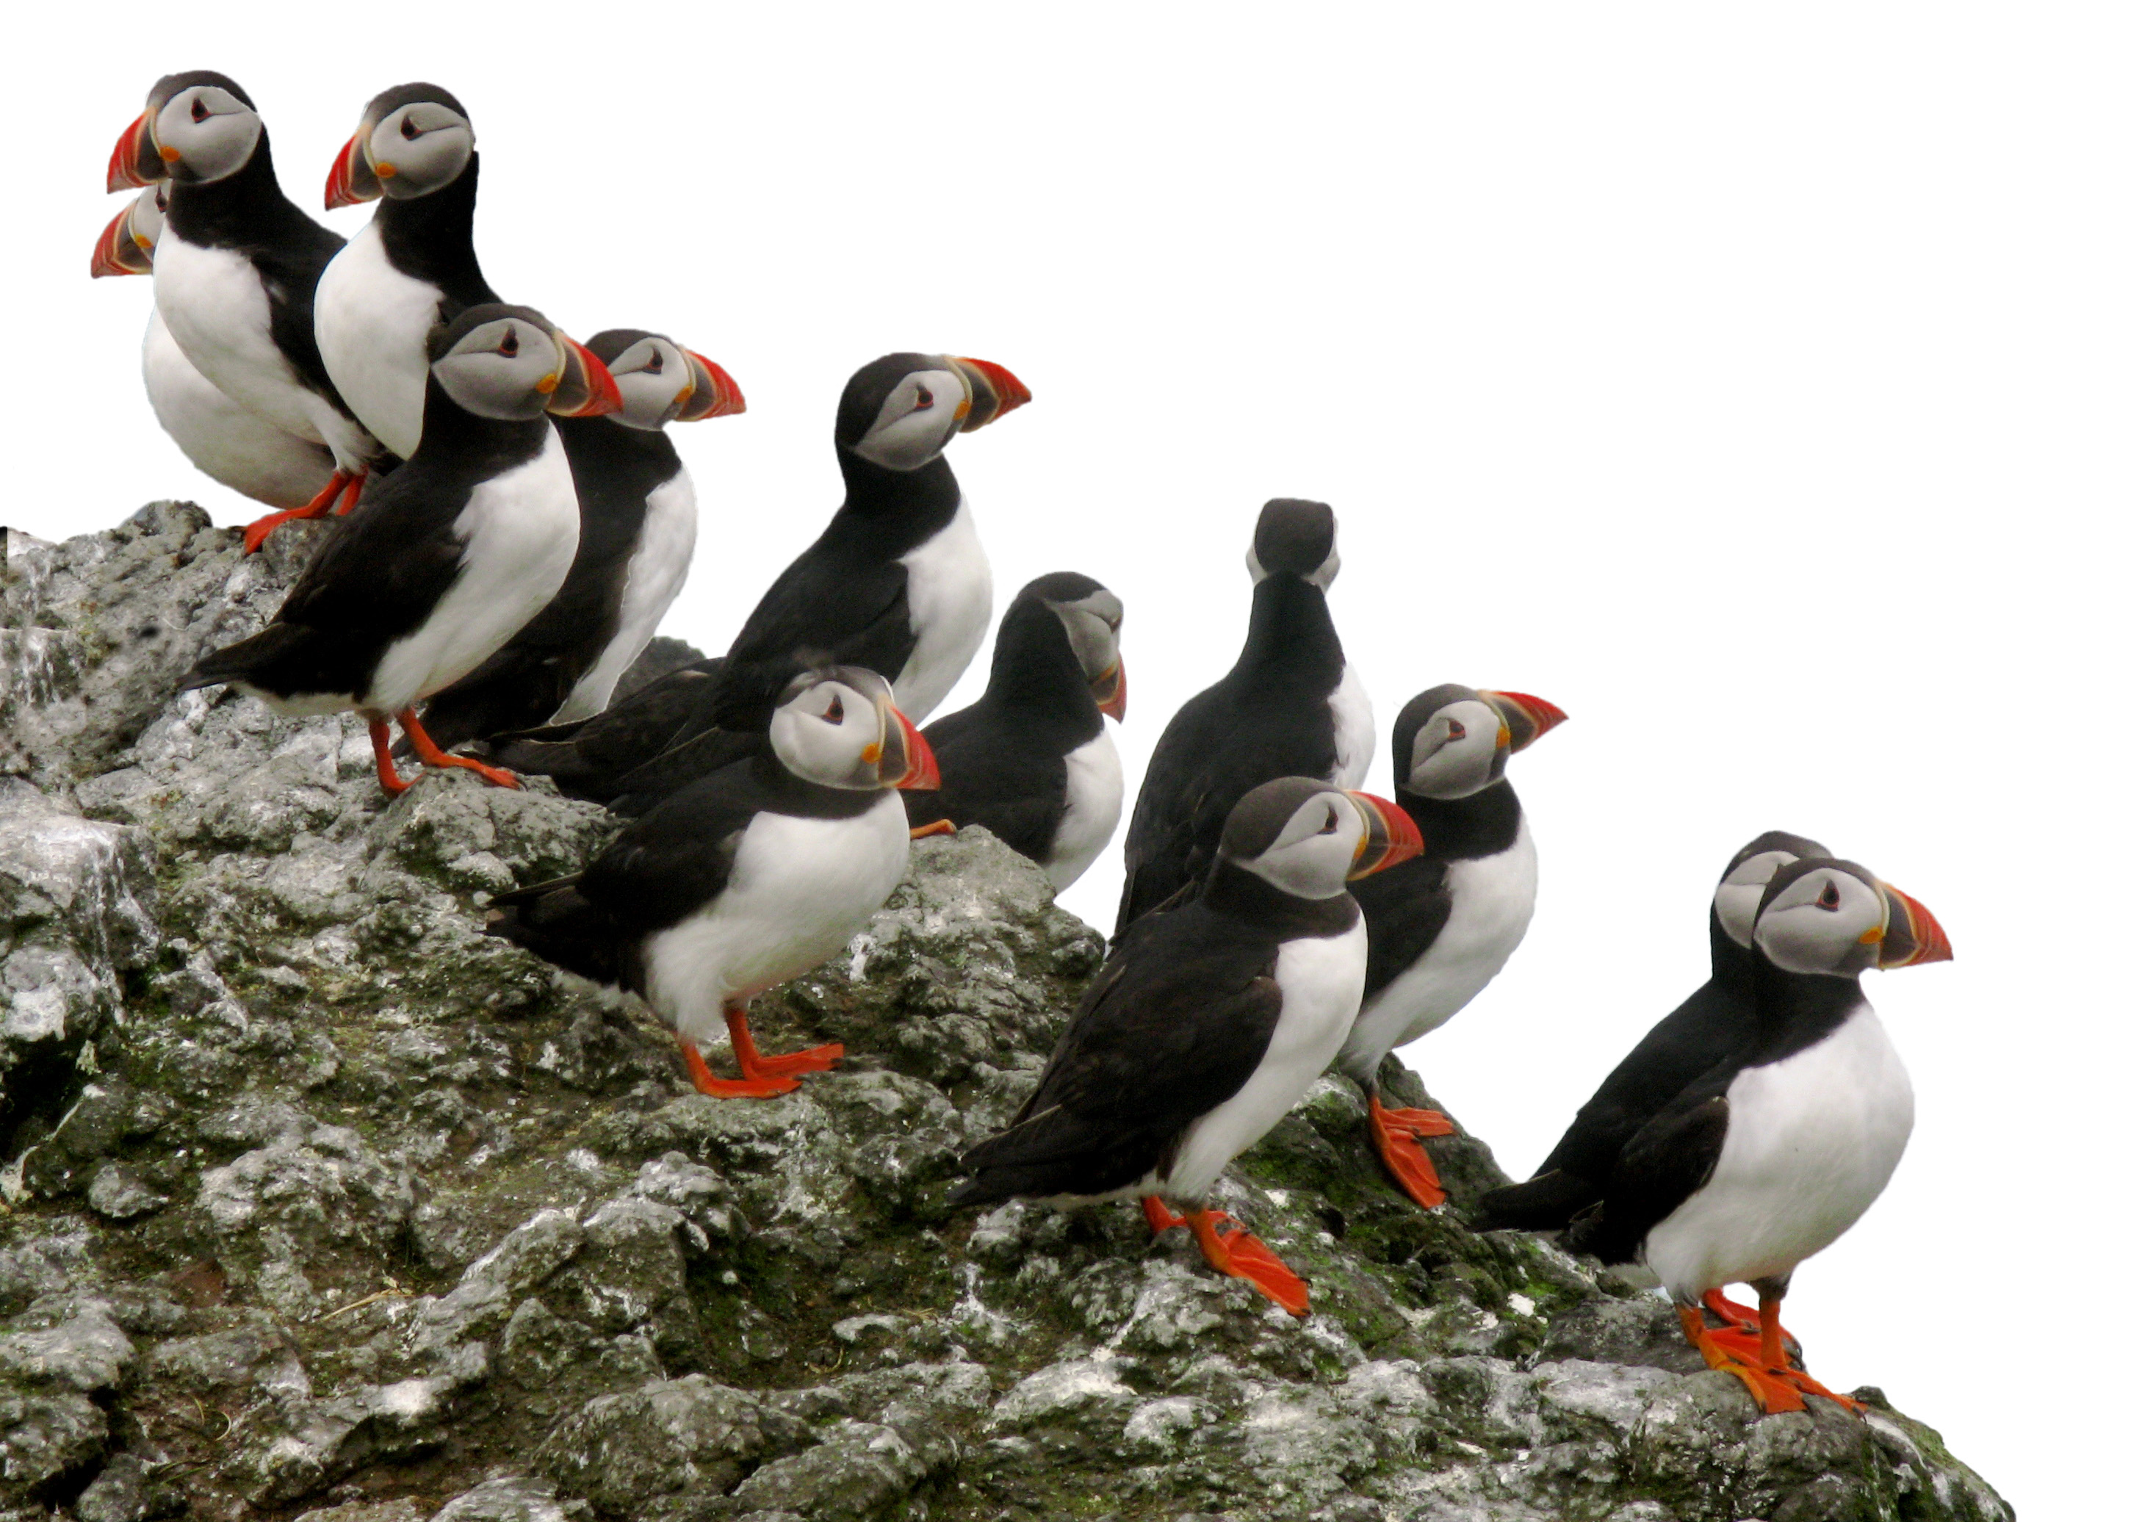
http://www.lel.ed.ac.uk/~heycock/faroese-project
Thank you!

